Slide 1

CSE1007 - JAVA PROGRAMMING
Kaushik Hariharan G
Assistant Professor
School of Computer Science and Engineering
Vellore Institute of Technology, Vellore

Slide 2
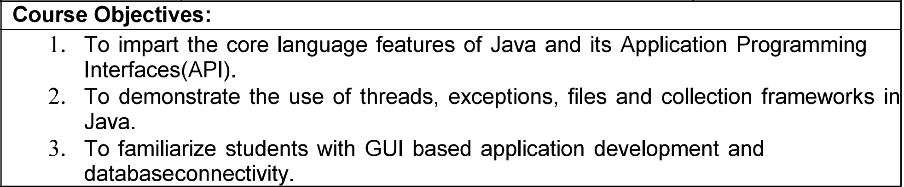
CSE1007 - Java Programming
Course Objectives

Slide 3
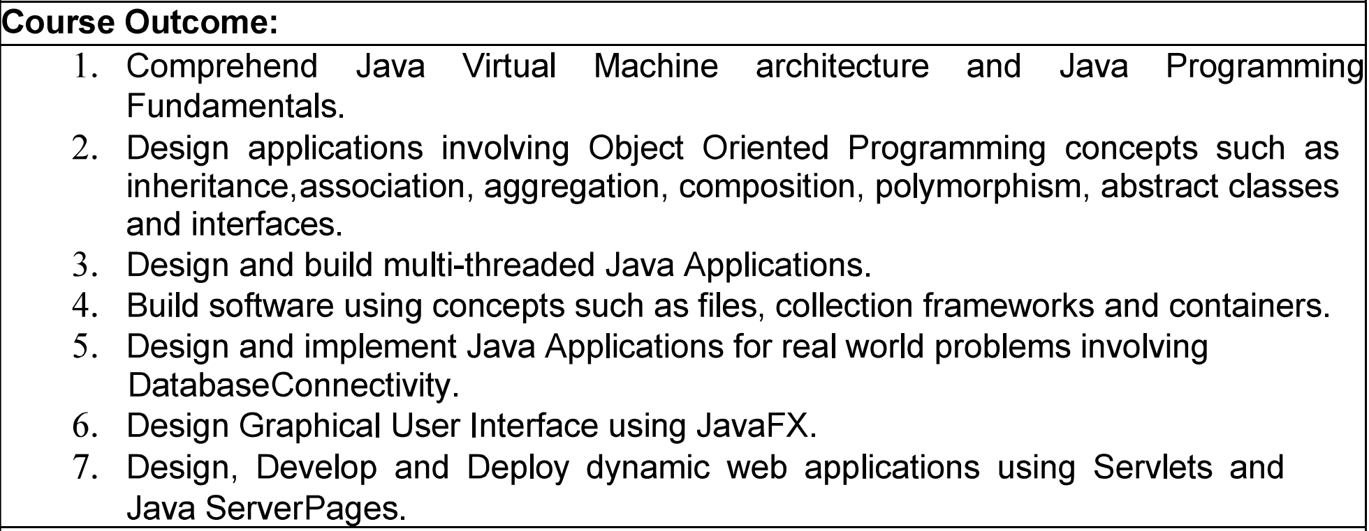
CSE1007 - Java Programming
Course Outcomes

Slide 4
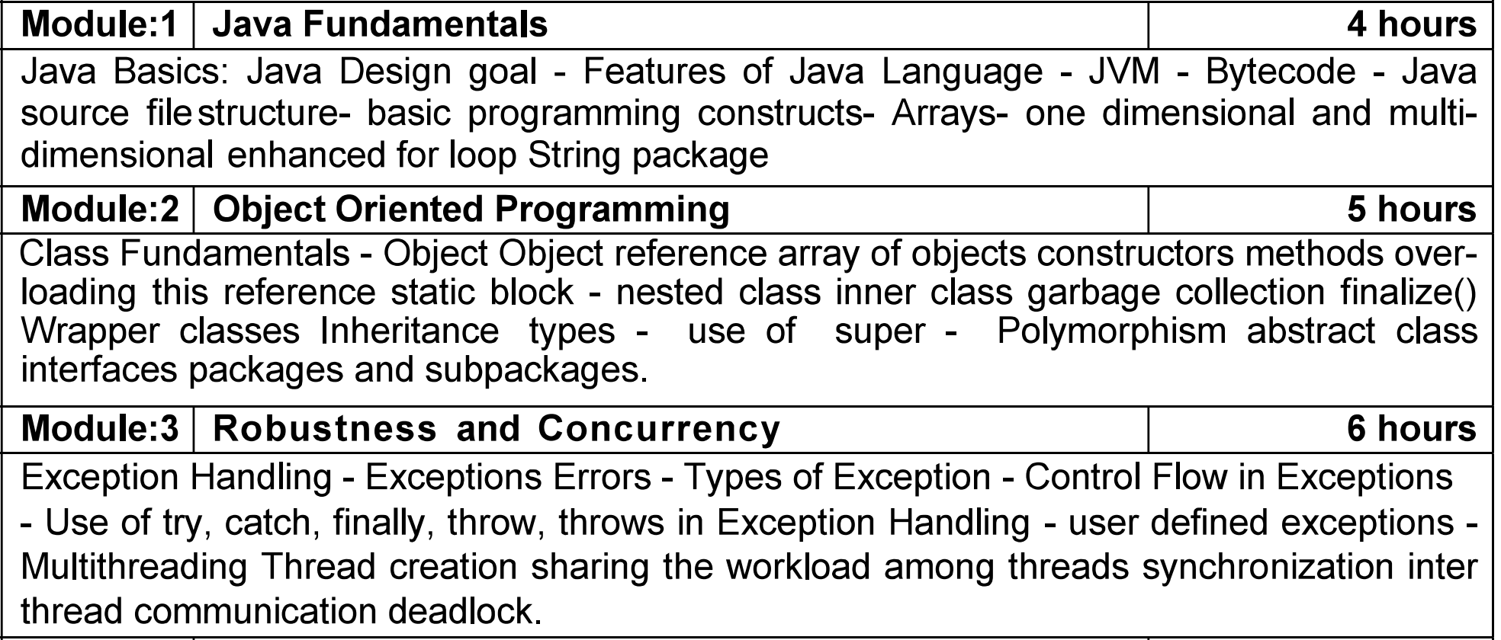
CSE1007 - Java Programming
Syllabus

Slide 5
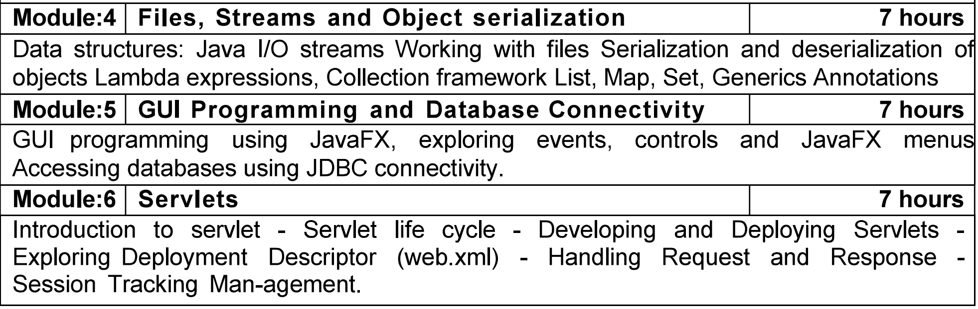
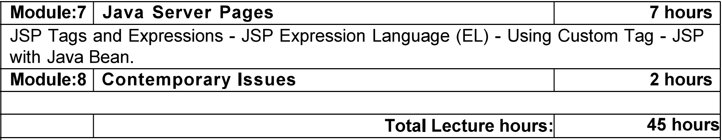
CSE1007 - Java Programming
Syllabus

Slide 6
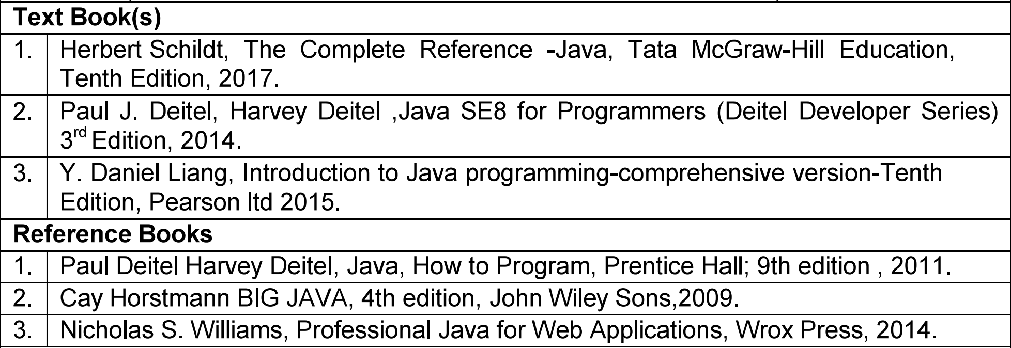
CSE1007 - Java Programming
Text and Reference Books

Slide 7
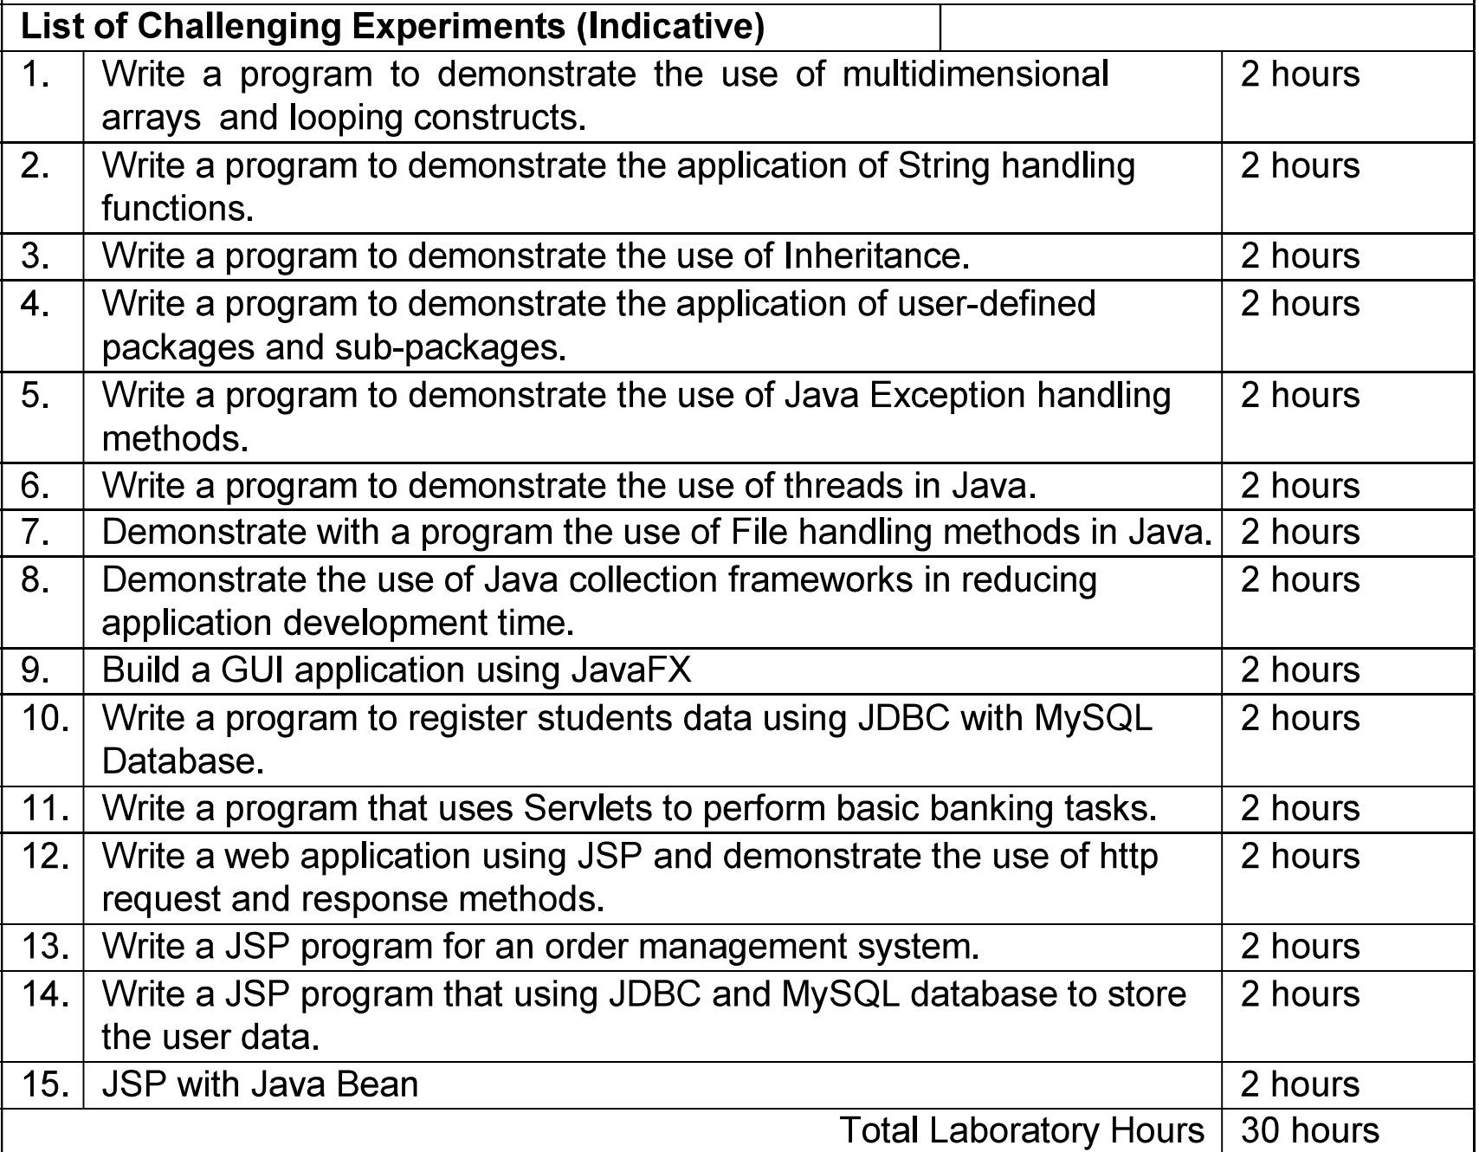
CSE1007 - Java Programming

Slide 8
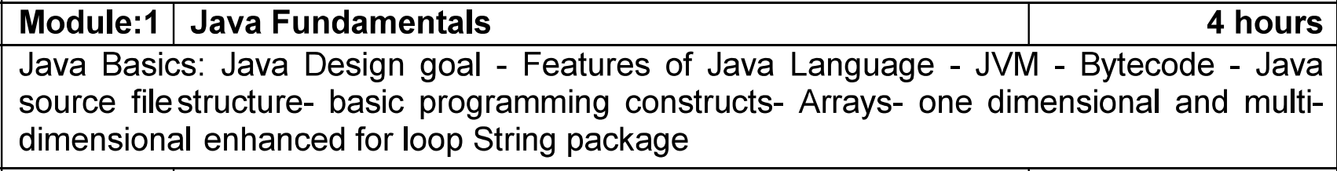
CSE1007 - Java Programming
Module 1

Slide 9

INTRODUCTION TO JAVA
Java is a purely object-oriented language.
In 1991, James Gosling and Patrick Naughton developed a language named “OAK” at Sun Microsystems.
Java is simple and platform-independent.
In 1995, this language was renamed as Java.
Java history is interesting to know. The history of Java starts from the Green Project.

Slide 10
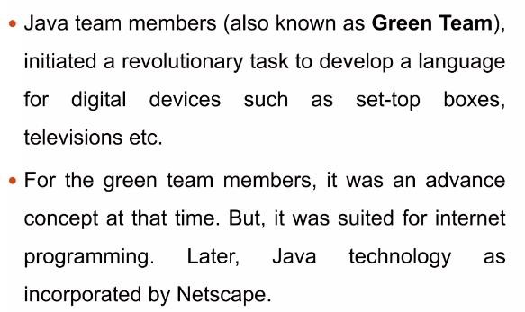

Slide 11
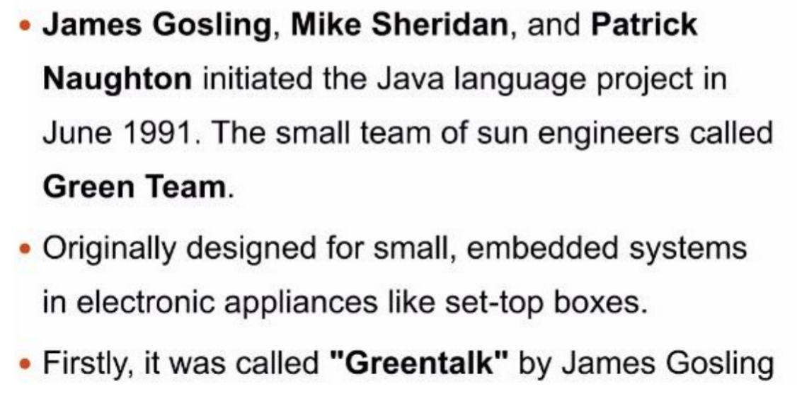

Slide 12

After that, it was called Oak and was developed as a part of the Green Project.
Why Oak? Oak is a symbol of strength and was chosen as the national tree of many countries like the USA, France, Germany, and Romania.
In 1995, Oak was renamed as Java because the name Oak was already a trademark by Oak Technology.

Slide 13
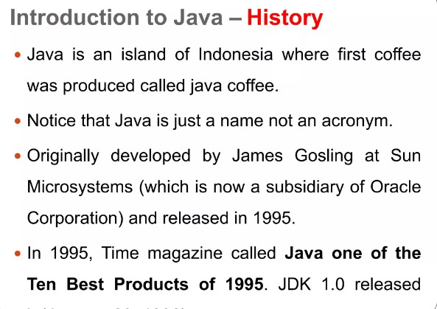

Slide 14
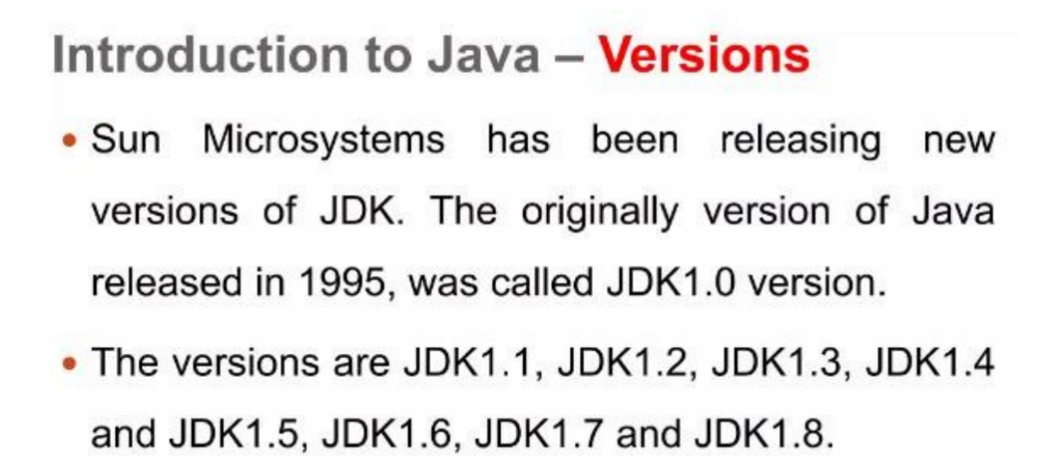

Slide 15
API, JDK, and IDE
The Application Program Interface (API), also known as library, contains predefined classes and interfaces for developing Java programs.
The JDK is the software for developing and running Java programs.
An IDE is an integrated development environment for rapidly developing programs.
Java is a full-fledged and powerful language that can be used in many ways. It comes in three editions:
  ■ Java Standard Edition (Java SE) to develop client-side applications. The applications can run standalone running from a Web browser.
  ■ Java Enterprise Edition (Java EE) to develop server-side applications, such as Java servlets, JavaServer Pages (JSP), and JavaServer Faces (JSF).
  ■ Java Micro Edition (Java ME) to develop applications for mobile devices.

Slide 16
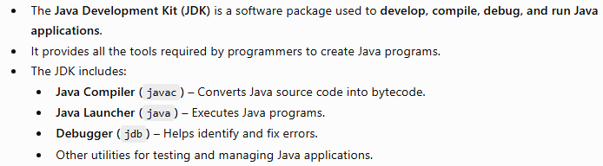
JDK

Slide 17
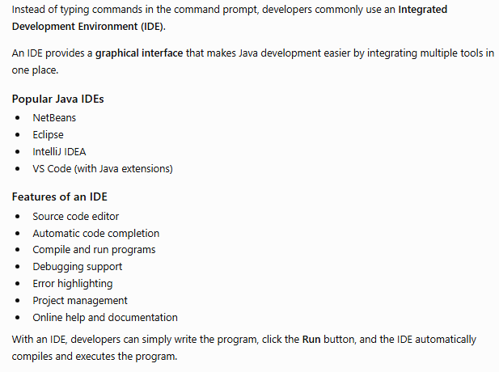
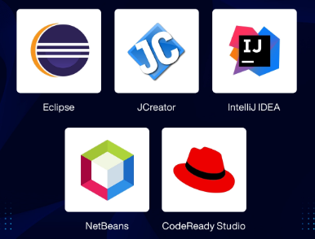
IDE

Slide 18

Bytecode

Slide 19
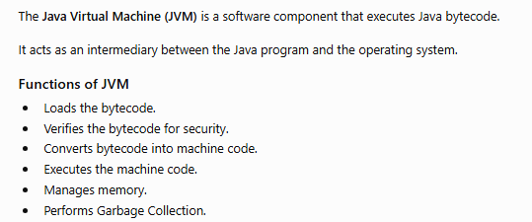
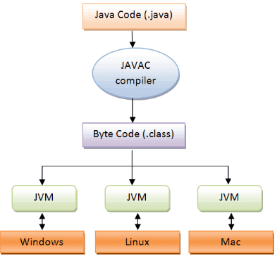
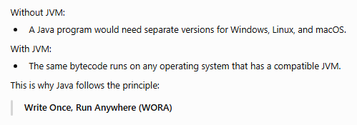
JVM

Slide 20
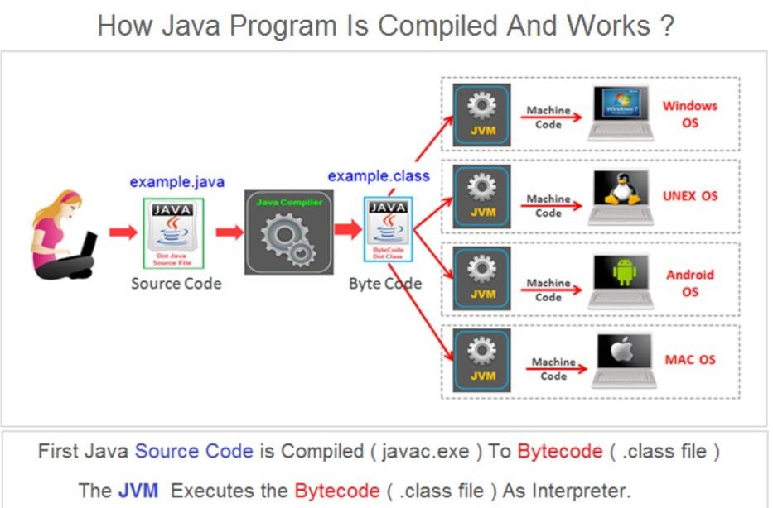

Slide 21
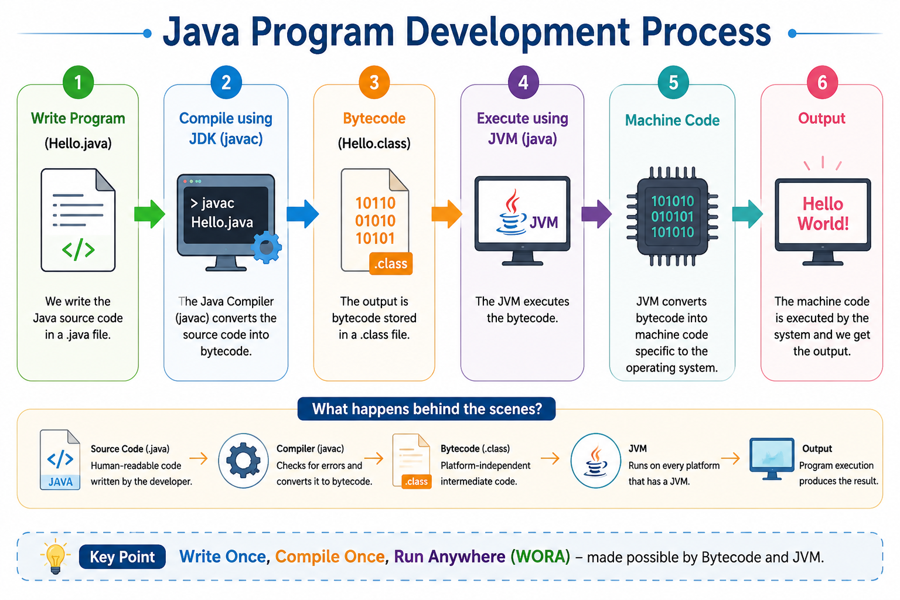

Slide 22
Java Design goal
The design goals of Java focus on creating a language that is simple, efficient, secure, and portable, while supporting modern software development needs.

Slide 23
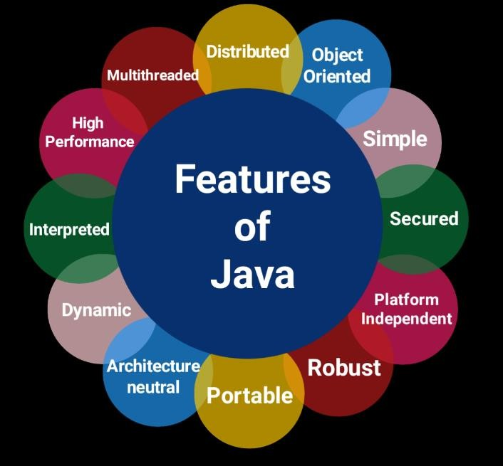

Slide 24
Simple
Java is a simple programming language.It removes some of the
complicated concepts such as:
Java doesn’t support complex concepts like pointers, operator overloading, so Java programs work as fast and its required less development time.
Java has added the concept of garbage collation to destroy
unnecessary objects automatically that free up memory.
It provides user-friendly syntax which is based on C++

Slide 25
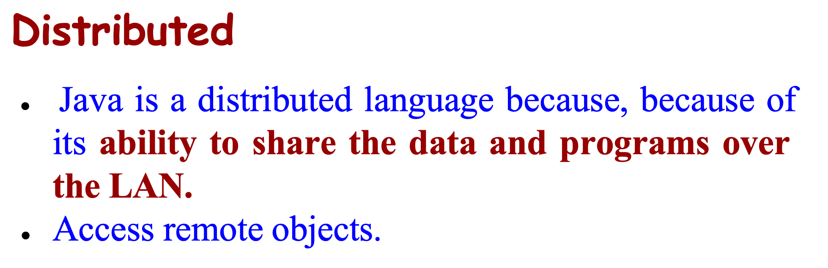
Object-oriented
Java is purely an Object Oriented Programming language i.e., all the code of the Java language is written into the classes and objects.

Slide 26
Secure
Multi-threaded
Java supports multi-threading programming, which allows us to write programs that do multiple operations simultaneously.
Java is said to be more secure programming language because it does not have pointers concept, java provides a feature "applet" which can be embedded into a web application.
The applet in java does not allow access to other parts of the
computer, which keeps away from harmful programs like viruses and unauthorized access.

Slide 27
Portable
Portability is one of the core features of java which enables the java programs to run on any computer or operating system.
For example, an applet developed using java runs on a wide variety of
CPUs, operating systems, and browsers connected to the Internet.
Robust
Java is more robust because the java code can be executed on a variety of environments, java has a strong memory management mechanism (garbage collector), java is a strictly typed language, it has a strong set of exception handling mechanism, and many more.

Slide 28
Architecture-neutral (or) Platform Independent
Java has invented to archive "write once; run anywhere, any time, forever". The java provides JVM (Java Virtual Machine) to to archive architectural-neutral or platform-independent. The JVM allows the java program created using one operating system can be executed on any other operating system.
Dynamic
Java is said to be dynamic because the java byte code may be dynamically updated on a running system and it has a dynamic memory allocation and deallocation (objects and garbage collector).

Slide 29
Interpreted
Java enables the creation of cross-platform programs by compiling into an intermediate representation called Java bytecode. The byte code is interpreted to any machine code so that it runs on the native machine.
High performance
Java provides high performance with the help of features like
JVM, interpretation, and its simplicity.

Slide 30
Java: Web and Beyond
Java is a versatile programming language that can be used to develop a wide range of applications, including:
Standalone Applications – Desktop applications that run independently on a computer. Ex: Media player, antivirus
Web Applications – Applications that run through a web browser and provide interactive online services.
Server-Side Applications – Enterprise and web server applications that process client requests and manage business logic.
Mobile Applications – Applications for smartphones, tablets, and other handheld devices.
Embedded and IoT Applications – Software for consumer electronics, smart devices, and embedded systems.
Cloud and Distributed Applications – Scalable applications that run across multiple systems and cloud platforms.

Slide 31
Constants
Java Basics
A constant is an identifier that is similar to a variable except that it holds the same value during its entire existence
As the name implies, it is constant, not variable
In Java, we use the reserved word final in the declaration of a constant
Syntax: final dataType CONSTANT_NAME = value;
    final int MIN_HEIGHT = 69;
Variables
A variable is a name for a location in memory
A variable must be declared by specifying the variable's name and the type of information that it will hold.
Ex:
  int total;
  int count, temp, result;

Slide 32
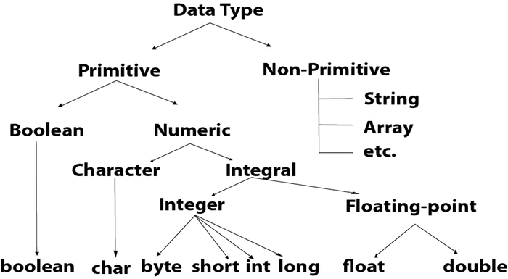
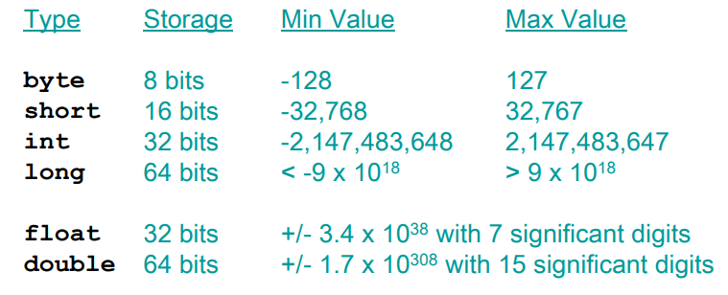
Data Types
Char and Boolean
  char in Java is 16 bit
  Char ranges from 0 to 65535
  Boolean is a primitive data type, it can either take true or false

Slide 33
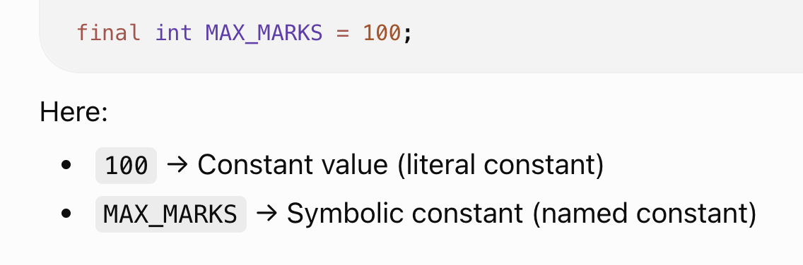
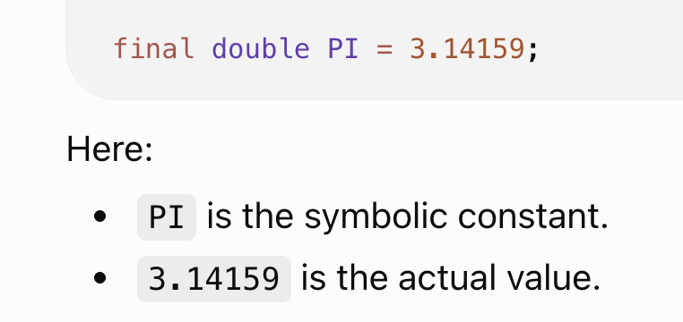
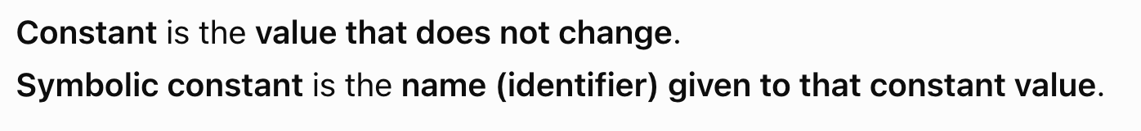
Symbolic constant
public class Student{
public static final int NUM_GRADES = 5;
private String name;
private int[] grades;
public Student(String name){
this.name = name;
this.grades = new int[NUM_GRADES];
}
}

Slide 34
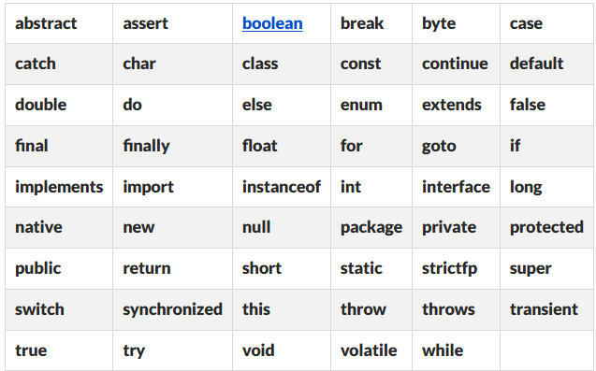
Reserved words

Slide 35
Identifiers/Variables
They can contain alphabets, digits, underscore (_) and dollar sign ($).
They must not begin with a digit.
Java is case-sensitive; uppercase and lowercase letters are treated as different identifiers.
Keywords cannot be used as identifiers.
Spaces are not allowed in identifiers.
Special characters such as @, #, %, &, etc., are not allowed (except _ and $).

Slide 36
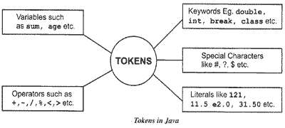
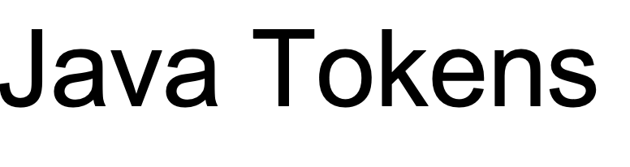
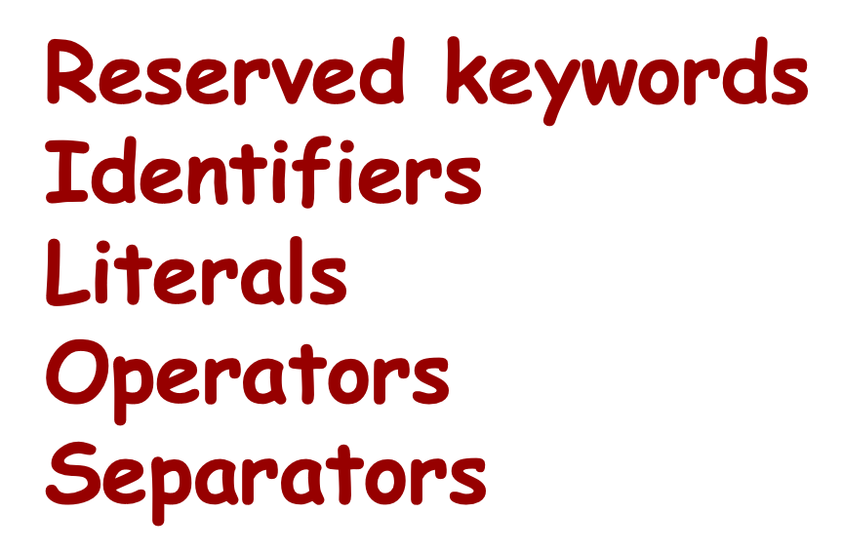
Java Tokens

Slide 37
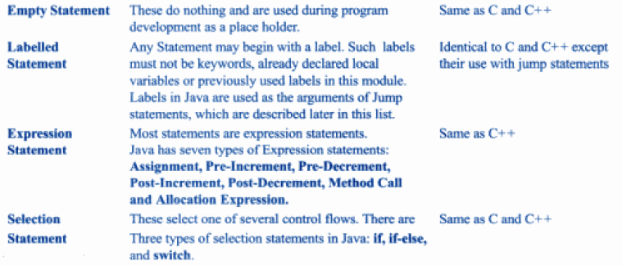
Java Statements

Slide 38
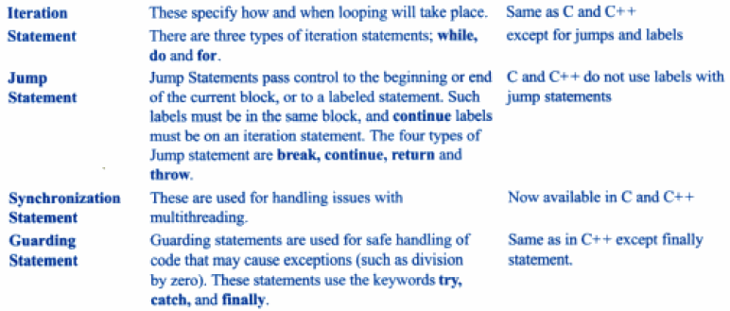
Java Statements

Slide 39
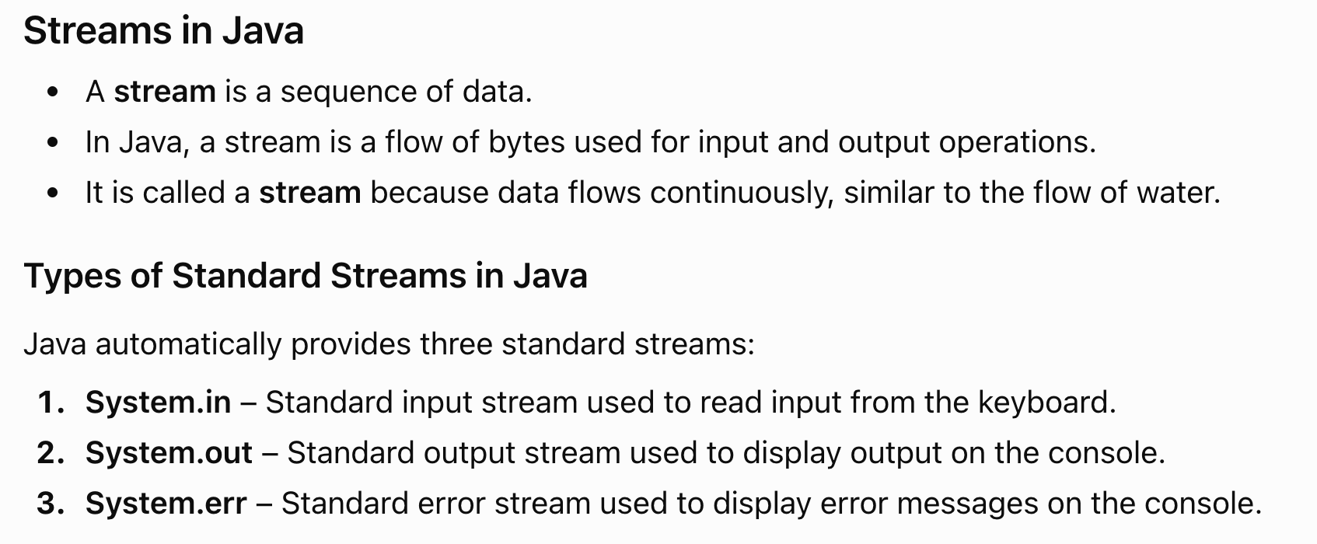
Streams

Slide 40
Java Operators
Java provides a rich set of operators to manipulate variables. We can divide all the Java operators into the following groups
  Arithmetic Operators
  Relational Operators
  Bitwise Operators
  Logical Operators
  Assignment Operators
  Special Operators (Conditional Operator ( ? : ))
  variable x = (expression) ? value if true : value if false

Slide 41
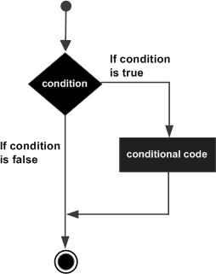
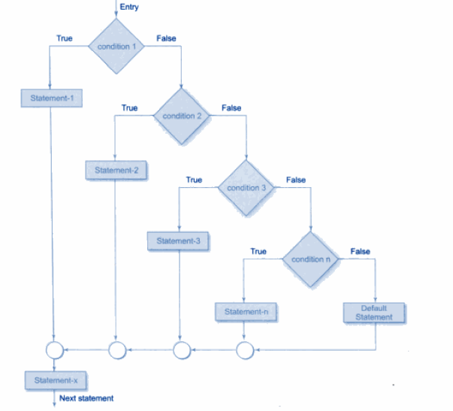
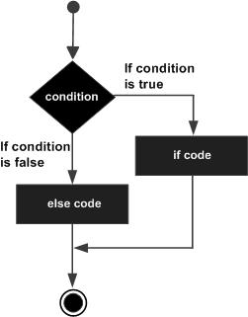
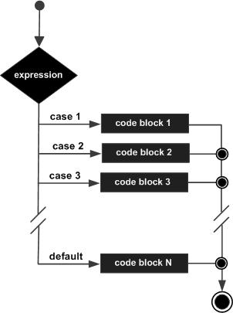
if statement
Decision Making or Conditional Statement
if-else statement
Else if ladder
Switch Case statement

Slide 42
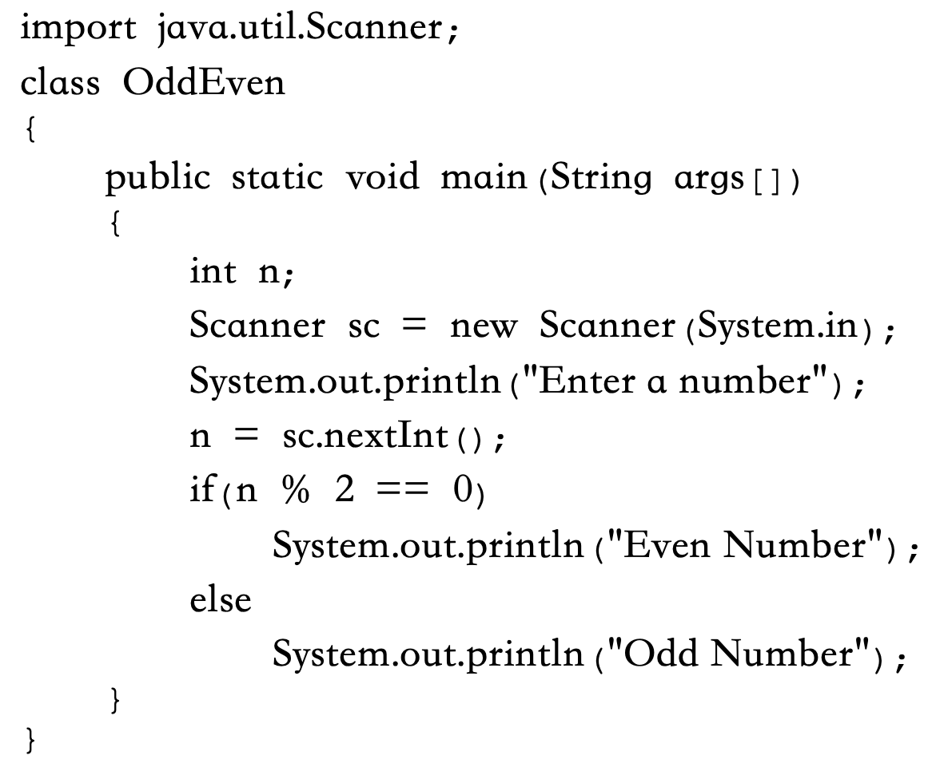
Java Program to check whether a number is ODD or EVEN

Slide 43
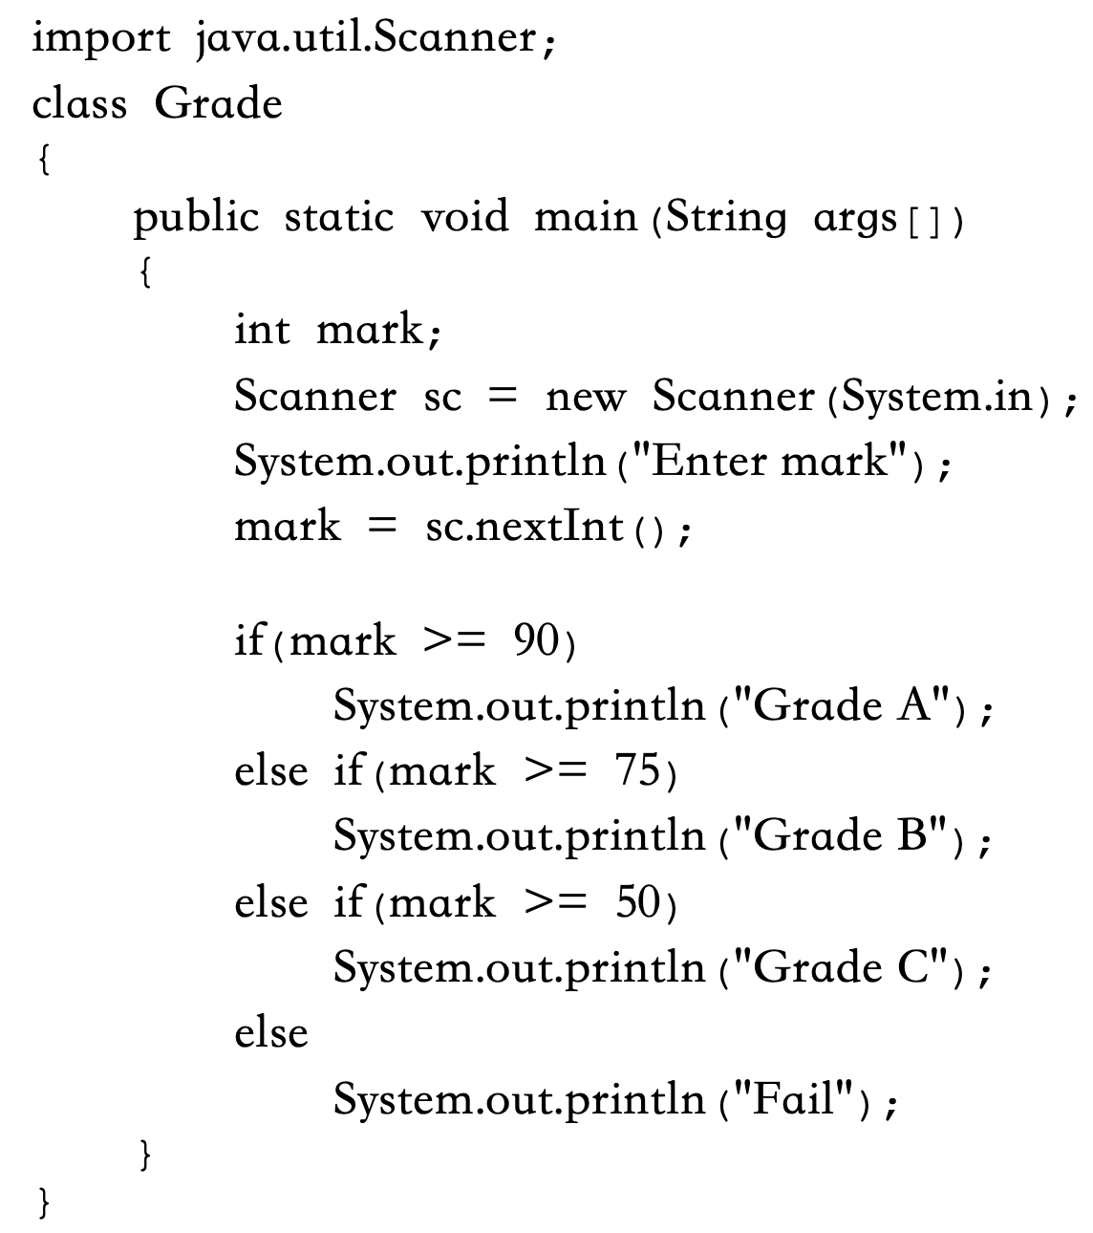
Grade Calculation

Slide 44
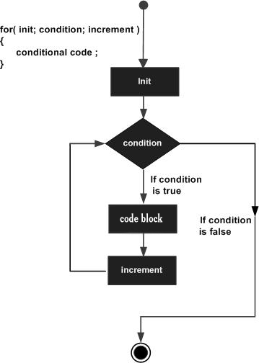
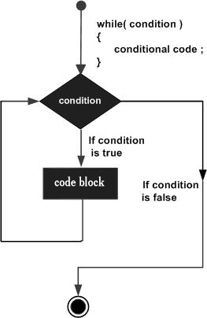
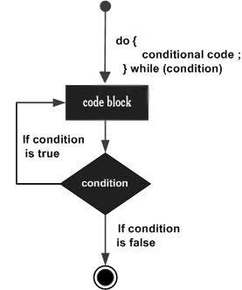
Java Looping Statements
While
for
do..While

Slide 45

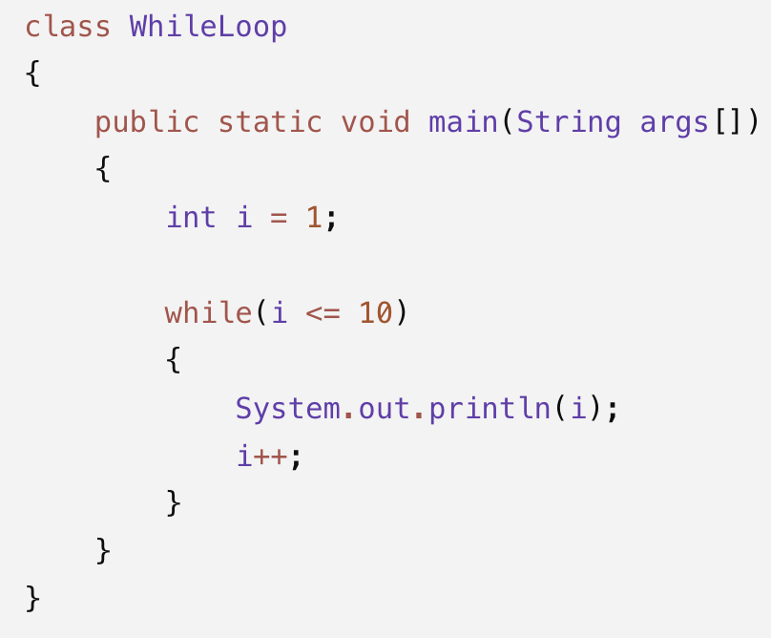
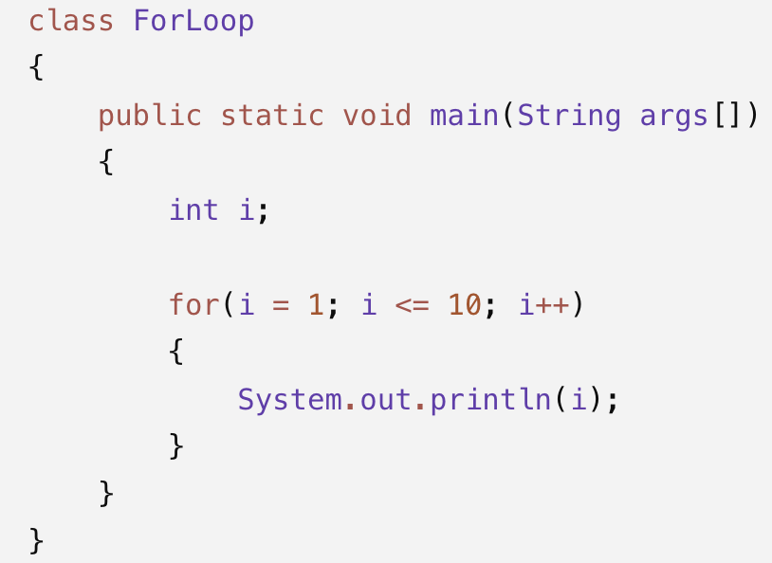
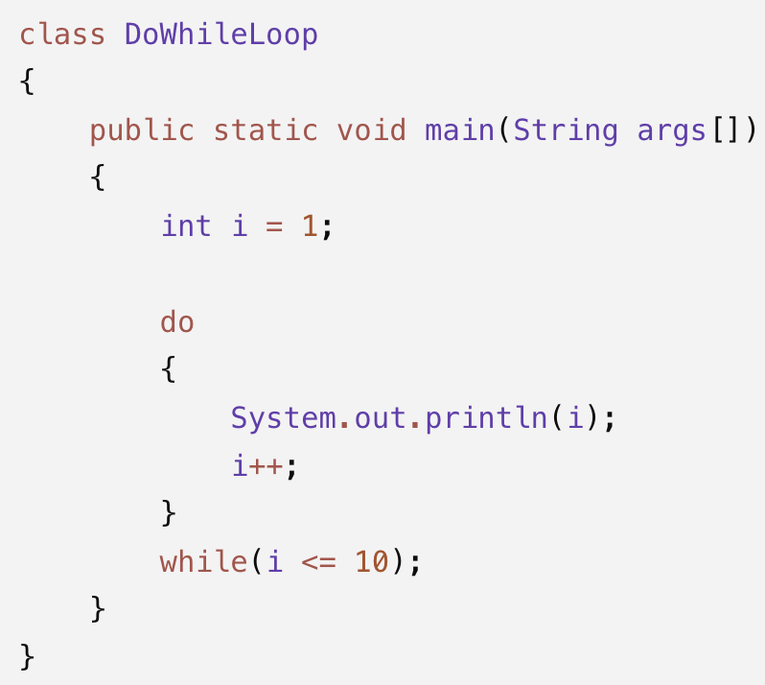

Slide 46
Loop Control Statements
Loop control statements change execution from its normal sequence. When execution leaves a scope, all automatic objects that were created in that scope are destroyed.
Java supports the following control statements.
  break statement
    Terminates the loop or switch statement and transfers execution to the statement immediately following the loop or switch.
  continue statement
    Causes the loop to skip the remainder of its body and immediately retest its condition prior to reiterating.

Slide 47
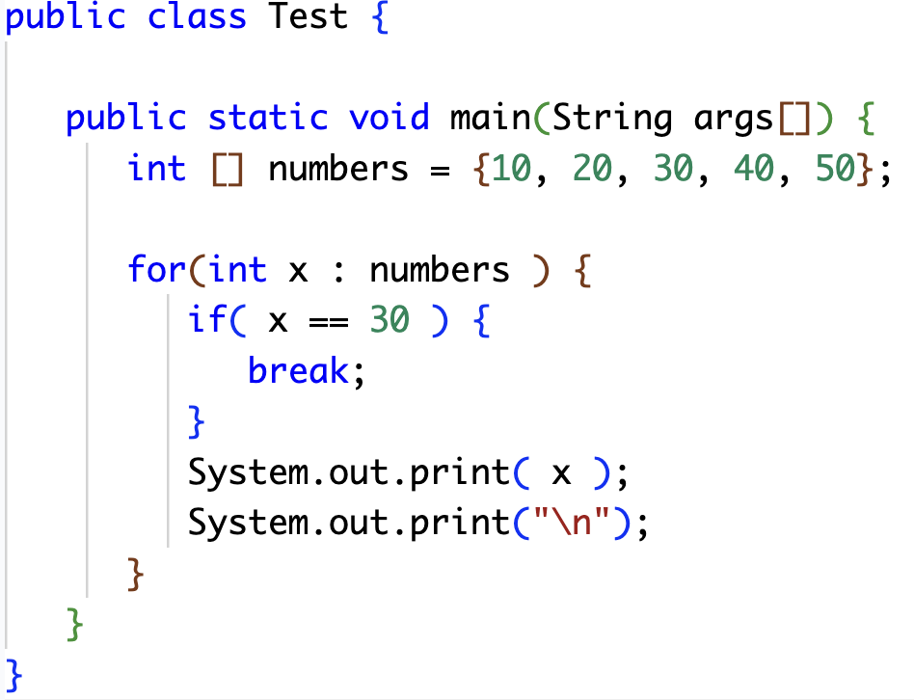
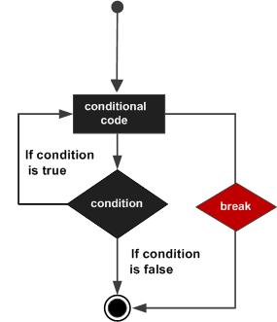

break
The break statement in Java programming language has the following two usages −
  When the break statement is encountered inside a loop, the loop is immediately terminated and the program control resumes at the next statement following the loop.
  It can be used to terminate a case in the switch statement

Slide 48
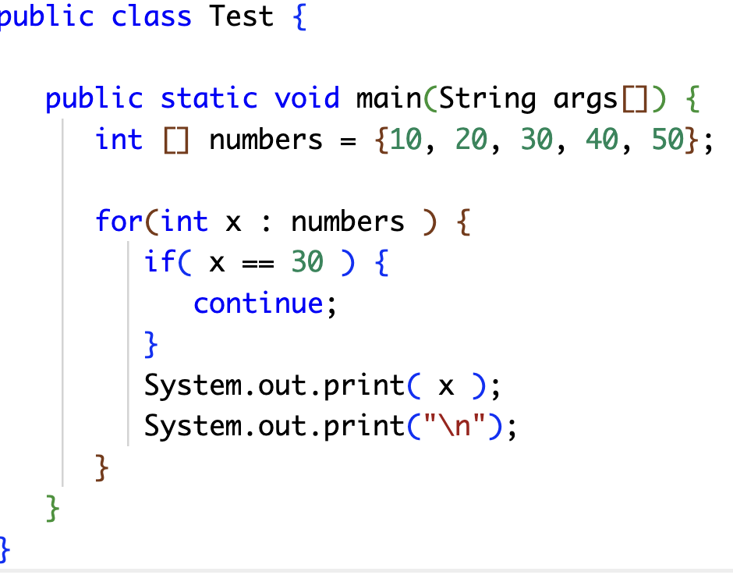
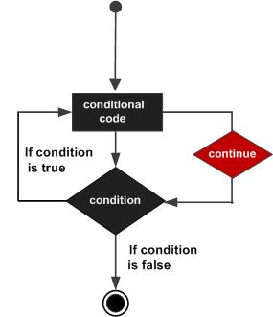

continue
The continue keyword can be used in any of the loop control structures. It causes the loop to immediately jump to the next iteration of the loop.

Slide 49

Java Programming Structure

Slide 50


Slide 51


Slide 52


Slide 53


Slide 54
Single-line Comments
Single-line comments start with two forward slashes (//).
System.out.println("Hello World"); // This is a comment
Java Multi-line Comments
Multi-line comments start with /* and ends with */.
/* The code below will print the words Hello World
to the screen, and it is amazing */
System.out.println("Hello World");

Slide 55

Syntax of a Class class <class_name>
Declaring a Java Method
The syntax to declare a method is:
returnType methodName()
{
// method body
}
{
field; method;
}

Slide 56

Basic programming constructs

Slide 57

Simple Java Program

Slide 58

Java Program to perform Addition of 2 Numbers

Slide 59


Arrays
Arrays are used to store multiple values in a single variable, instead of declaring separate variables for each value.
Without arrays:
With arrays:
int mark1 = 90;
int mark2 = 85;
int mark3 = 78;
int mark4 = 88;
int mark5 = 92;
int marks[] = {90, 85, 78, 88, 92};

Slide 60
Declaring an Array Variable
Do not have to create an array while declaring array variable
-<type> [ ] variable_name;
-double[ ] myList;
-double myList[ ];
Both syntaxes are equivalent
No memory allocation at this point

Slide 61
Array Creation
Defining an Array: Define an array as follows:
-variable_name=new <type>[arraySize];
-Number = new int[5];
-Mylist = new int[10];
It creates an array using new dataType[arraySize];
·
·Array index starts from 0 to arraySize-1;
·int is of 4 bytes, total space=4*10=40 bytes Declaring and defining in the same statement:
double [ ] mylist = new double[10]; int mylist[]=new int[5];
·

Slide 62


Array Initialization
Syntax:
·dataType arrayname[ ] = {values};
·int a [ ]={1,2,3,4,5,6,7,};

Slide 63



Slide 64


Slide 65


One-Dimensional Array (1D Array) – Displaying Array Elements

Slide 66


Read 5 elements from the user and display them.

Slide 67

Two dimensional array
A two-dimensional array is an array of arrays. It can be visualized as a matrix or a table, where data is arranged in rows and columns.
In Java, a two-dimensional array is essentially an array where each element is an array itself. This allows you to store multiple rows of data, and each row can have multiple columns.
Syntax:
dataType[][] arrayName;
or
dataType arrayName[][];

Slide 68

int array1[][]= new int[4][5];

Slide 69


Two-Dimensional Array (2D Array) – Displaying Array Elements

Slide 70
Multi Dimensional Arrays
A multidimensional array is an array that contains one or more arrays as its elements.
A three-dimensional array stores data in the form of blocks (layers), rows and columns.

Slide 71


Three-Dimensional Array (3D Array) – Displaying Array Elements

Slide 72


Slide 73



Slide 74

Enhanced for loop
The Enhanced for Loop, also known as the for-each loop, is used to traverse the elements of an array or collection without using an index variable.
The Enhanced for Loop is a simplified version of the for loop that automatically accesses each element of an array.
Syntax:
for(dataType variable : arrayName)
{
// statements
}

Slide 75


Example: One-Dimensional Array

Slide 76


Example: Two-Dimensional Array

Slide 77
String
A String is an object that represents a sequence of characters.
Strings can contain letters, digits, symbols and spaces.
Strings are widely used for storing names, messages, addresses and other textual information.
String city = "Vellore";
String message = "Welcome to Java";

Slide 78
Creating Strings in Java
Strings can be created in two ways:
Using String Literal
String s1 = "Hello";
Using new Keyword
String s2 = new String("Hello");

Slide 79
String Objects
Every string created in Java is an object of the String class.
String objects provide built-in methods to manipulate text.
String language = "Java";
language → String object (reference variable)
"Java" → String literal
The String object stores the value "Java".

Slide 80
String Class
The String class belongs to the java.lang package.
It provides numerous methods to perform operations on strings.
Methods:
length()
charAt()
substring()
toUpperCase()
toLowerCase()

Slide 81
Immutable Strings
Strings in Java are immutable.
Once a string object is created, its value cannot be changed.
Any modification creates a new string object
If we perform any operation on a string, Java does not modify the existing object. Instead, it creates a new String object and stores the modified value in it.
String s = "Java";
s = s + " Programming";
A new string object is created.

Slide 82
String Declaration and Initialization
Declaration
String name;
Initialization
name = "Java";
Declaration and Initialization Together
String name = "Java";

Slide 83
String Methods
Common methods provided by the String class:
length()
charAt()
substring()
equals()
compareTo()
toUpperCase()
toLowerCase()
trim()
replace()

Slide 84
Common String Operations
Reading a string
Displaying a string
Comparing strings
Concatenating strings
Searching characters
Extracting substrings

Slide 85
String s = "Java";
System.out.println(s);
String s1 = "Java";
String s2 = "Java";
System.out.println(s1.equals(s2));
String first = "Java";
String second = "Programming";
String result = first + " " + second;
String s = "Java";
System.out.println(s.length());

Slide 86

String s = "Java";
System.out.println(s);
String s1 = "Java";
String s2 = "Java";
System.out.println(s1.equals(s2));
String first = "Java";
String second = "Programming";
String result = first + " " + second;
String s = "Java";
System.out.println(s.length());

Slide 87
Extracting Characters from a String
The charAt() method returns a character at a specified position.
String s = "Java";
System.out.println(s.charAt(2));
Converting Case
String s = "java";
System.out.println(s.toUpperCase());
String s = "JAVA";
System.out.println(s.toLowerCase());

Slide 88


Extracting Characters from a String
The charAt() method returns a character at a specified position.
String s = "Java";
System.out.println(s.charAt(2));
Converting Case
String s = "java";
System.out.println(s.toUpperCase());
String s = "JAVA";
System.out.println(s.toLowerCase());

Slide 89
Splitting a String
The split() method divides a string into multiple parts.
String s = "Java,Python,C";
String arr[] = s.split(",");
Output:
Java
Python
C
Converting Other Data Types to String
Using String.valueOf()
Example:
int num = 100;
String s = String.valueOf(num);
Output:
"100"

Slide 90
Searching in a String
The indexOf() method is used to find the position of a character.
String s = "Programming";
System.out.println(s.indexOf('g'));
Output:3
Replacing Characters and Substrings
The replace() method replaces characters or words.
String s = "Java";
System.out.println(s.replace('J', 'K'));
Output: Kava

Slide 91
Extracting a Substring
The substring() method extracts part of a string.
String s = "Programming";
System.out.println(s.substring(3,7));
Output: gram
Trimming Whitespaces
The trim() method removes leading and trailing spaces.
String s = " Java ";
System.out.println(s.trim());
Output: Java
beginIndex → Starting index (included).
endIndex → Ending index (excluded)

Slide 92

T

Slide 93


Slide 94



Slide 95
A String object cannot be modified after it is created because it is immutable.
Whenever a String is modified, Java creates a new object, which consumes additional memory and time.
Hence, Many objects are created, which reduces performance.
Solution: StringBuffer and StringBuilder
Both classes are mutable, meaning the same object is modified instead of creating new objects.
Java provides these two mutable classes because different applications have different requirements.

Slide 96
StringBuffer Class
StringBuffer is a class used to store and manipulate a sequence of characters.
It is mutable, which means its contents can be modified after creation.
It is thread-safe, making it suitable for multithreaded applications.
Common methods include append(), insert(), delete(), replace(), and reverse().
Example:
StringBuffer sb = new StringBuffer("Java");
sb.append(" Programming");
Output:
Java Programming

Slide 97


1. append() method
The append() method appends (adds) the specified string to the end of the existing StringBuffer object.

Slide 98


2. insert() method
The insert() method inserts the specified string at the given index position in the existing StringBuffer.

Slide 99


3. replace() method
The replace() method replaces the characters between the specified start index (inclusive) and end index (exclusive) with the given string.

Slide 100


4. delete() method
The delete() method removes the characters between the specified start index (inclusive) and end index (exclusive) from the existing StringBuffer.
Example:

Slide 101


5. reverse() method
The reverse() method reverses the sequence of characters in the existing StringBuffer.

Slide 102
StringBuilder Class
StringBuilder is also a predefined class in Java.
It is mutable, so its contents can be modified after creation.
It works similarly to StringBuffer.
It is not thread-safe.
It is faster than StringBuffer because it does not perform synchronization.
Example:
StringBuilder sb = new StringBuilder("Java");
sb.append(" Programming");

Slide 103


Slide 104



Slide 105


Few methods of StringBuilder class
StringBuilder append() method
  The StringBuilder append() method concatenates the given argument with this String.

Slide 106


2) StringBuilder insert() method
  The insert() method inserts the specified string at the given index position in the existing StringBuilder object.

Slide 107
Other Methods of StringBuilder
Method | Description
deleteCharAt(int index) | Deletes the character at the specified index.
setCharAt(int index, char ch) | Replaces the character at the specified index.
length() | Returns the length of the string.
capacity() | Returns the current capacity of the StringBuilder.
charAt(int index) | Returns the character at the specified index.
substring(int start) | Returns a substring from the specified index.
substring(int start, int end) | Returns a substring between two indices.
toString() | Converts the StringBuilder object into a String.

Slide 108
Difference Between StringBuffer and StringBuilder
StringBuffer
Synchronized (Thread-safe)
Safe for multi-threaded applications
Slower due to synchronization
Suitable when multiple threads access the same object
StringBuilder
Not synchronized (Not thread-safe)
Faster than StringBuffer
Suitable for single-threaded applications
Preferred when performance is important
StringBuffer is synchronized and thread-safe, whereas StringBuilder is not synchronized, not thread-safe, and provides better performance.

Slide 109

Comparison of String, StringBuffer and StringBuilder

Slide 110
Thank You

